Slide 1
“Towards a women oriented Medicine. European women doctors’ life and work : facilitations and barriers”
Women doctors: a different way to build relationships and achieve results in the Healthcare System
Dr. Alessandra Spedicato

Slide 2
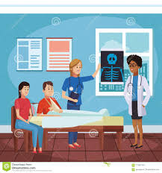
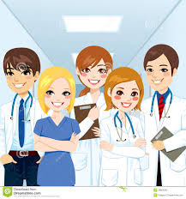
TACKLE CLIMATE CHANGE
NEXT NASA MISSION
TREATMENT OF A CANCER PATIENT
Dr. Alessandra Spedicato

Slide 3
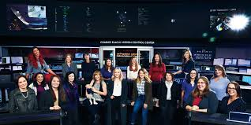
A multidisciplinary approach
Different professionals
Leadership is distributed at different points of time
Mutual acknowledge of the leader role
… Team members will be all women!
Dr. Alessandra Spedicato

Slide 4
Management of complex systems
Professionals’ interaction
Growing and preponderant female representation
Healthcare system is a complex system
A different model of leadership in the Healthcare System
Dr. Alessandra Spedicato

Slide 5
Fisher and Bajaj (2017). Learning how to ask: Women and Negotiation, Plastic and Reconstructive Surgery 139: 753, 2017.
Women are less likely to initiate a negotiation
Waiting to be noticed and rewarded
Act as team players
If they ask, they are perceived negatively
In a bargaining, women feel more comfortable to build relationships
Kristoffersson et al. (2016). Experiences of the gender climate in a clinical training – a focus group study among Swedish medical students, BMC Med Educ. 2016; 16:283
A subtle favouring of men throughout clinical training
Future physicians risk to reproduce a negative gender climate
Involving more and more women doctors as teachers, supervisors or leading roles
Dr. Alessandra Spedicato

Slide 6
Latu et al. (2019). Empowering Mimicry: Female Leader Role Models Empower Women in Leadership Tasks Through Body Posture and Mimicry, Sex Roles 2019; 80(1) 11-24.
Relevance of female leaders’ visibility
Empowerment by successfull female models
Ingroup mimicry effects
Women in high power position not only the goal but also a source
Lewis et al. (2018). Expanding Opportunities for Professional Development: Utilization of Twitter by Early Carreer Women in Academic Medicine and Science, JMIR Med Educ 2018 v.4(2) Jul-Dec 2018
Social media are providing new ways to connect and allow women in academic medicine to obtain the support they are otherwise lacking
Dr. Alessandra Spedicato

Slide 7
It’s time to reconsider leadership and leading models in Healthcare
“It is becoming more and more difficult for any single individual to possess all the skills and abilities required to competently lead organization today” O’toole, Galbraith & Lawler, 2002
It’s time to switch from a one-man management to a
SHARED LEADERSHIP!!!
Dr. Alessandra Spedicato

Slide 8
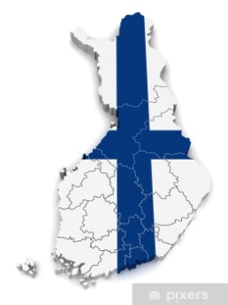
Shared leadership is a relational, collaborative leadership process or phenomenon involving teams or groups that mutually influence one another and collectively share duties and responsibilities otherwise relegated to a single central leader.
Kocolowsky (2010); Shared Leadership: Is It Time for a Change?, Emerging Leadership Journeys Vol.3 pp 22-32
Konu e Viitanen (2008) Shared Leadership in Finnish Social and Health Care Leadership in Health Services Vol 21 No.1 pp. 28-40
Shared Leadership was practiced most often by female managers.
Increasing in innovation, motivation and readiness for development.
Dr. Alessandra Spedicato

Slide 9
Work team resolves differences to reach agreements
Work is distributed properly to take advantage of members’unique skills
Informations about company’s strategy are shared
Teamwork is promoted with the team itself
Benefits
Two heads are better than one. Different leaders, one task-oriented and one-behavior oriented (Waldersee and Eagleson, 2002)
Reduced stress level
Increased creativity
Increased productivity
Dr. Alessandra Spedicato

Slide 10
Limits
Implementation of a new model is extremely difficult “changing people’s behavior when they have been in the same job for years is one of the hardest thing to do” S. Thornton –Health Service Journal 2007
Making decisions could take longer (but more awareness and team participation)
Risk of group thinking
Continual assessment and re-evaluation of the shared governance process
Need for distinct role definition and clear communication
COSTS
Dr. Alessandra Spedicato

Slide 11
Trade Union involvement in female leadership development: ANAAO Educational Project
AIM
To raise awareness of female authority in medical sector, through an Intedisciplinary Training Package
COURSE CONTENT
Lectures on the meaning of « taking care» in a women perspective - philosophical approach
Report and analysis of women doctors that influenced our society in the last two centuries (biographies/experience of empowerment /work struggles) - historical approach
Brain storming on trade union topics and issues ( famili-friendly organization, work-life balance, parental leave)
TOOLS
-Frontal lessons, Team working, medical pedagogic methods, role playing
EXPECTED OUTCOMES
To encourage cohesion and trust among participants
To increase , mostly at regional or local level, women doctors participation and empowerment
To provide women doctors future leader with appropriate tools of empowerment , confidence and cultural background
Dr. Alessandra Spedicato

Slide 12
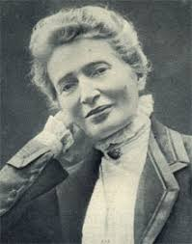
Shared leadership is about the quality of the interaction rather than people’s formal positions
It suits better to a system with a female prevalence
Clinical decision making is already delegated to a clinical team.
Decisions about strategies, resources and policy not yet.
OUR CHALLENGE: TO MAKE THIS MIND-CHANGE REAL.
Anna Kuliscioff. First female medical graduate in Italy
Dr. Alessandra Spedicato

Slide 13
Let us never negotiate out of fear. But let us never fear to negotiate
Dr. Alessandra Spedicato

