Slide 1
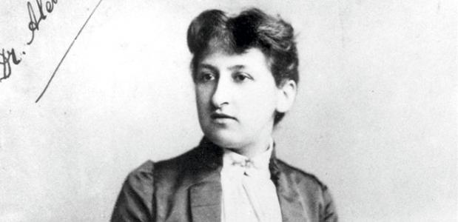
The participation of female physicians in the Dutch healthcare
Aletta Jacobs, the first female Dutch physician. She graduated in 1878

Slide 2
Some statistics 1: from the old days…

Slide 3
Some statistics 2: more recent
Percentage women starting in medical professions
Women’s share in new certified basic doctors
Women’s share in new certified GP’s
Women’s share in new certified medical specialists

Slide 4
Some statistics 3: number male and femal GP’s

Slide 5
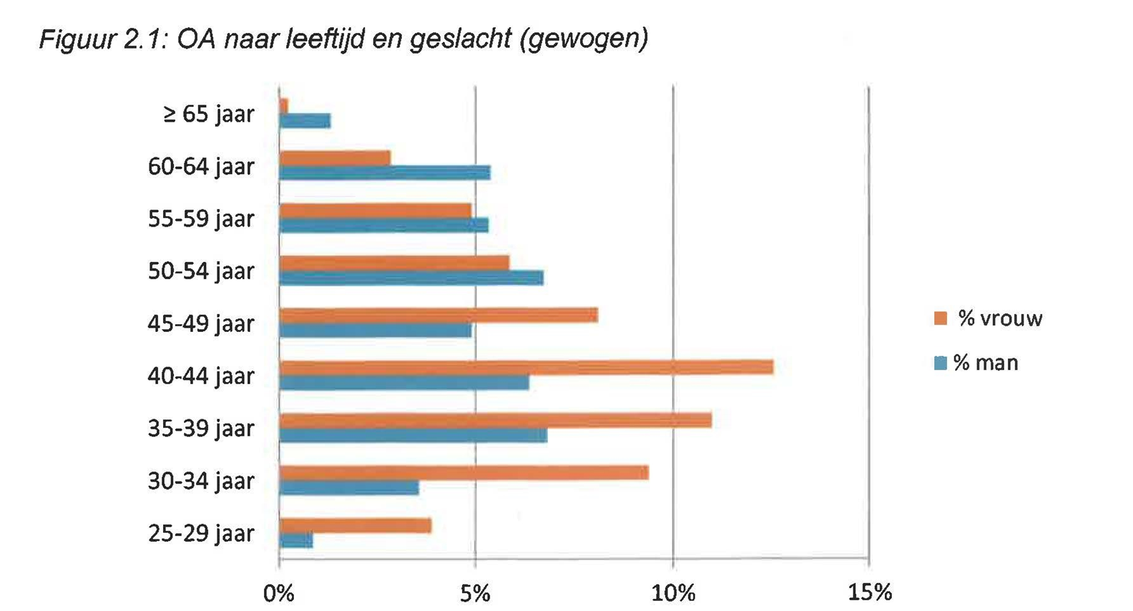
Even more statistics :
Pharmacists
Women
Men
(Bron: Kiwa Carity)

Slide 6
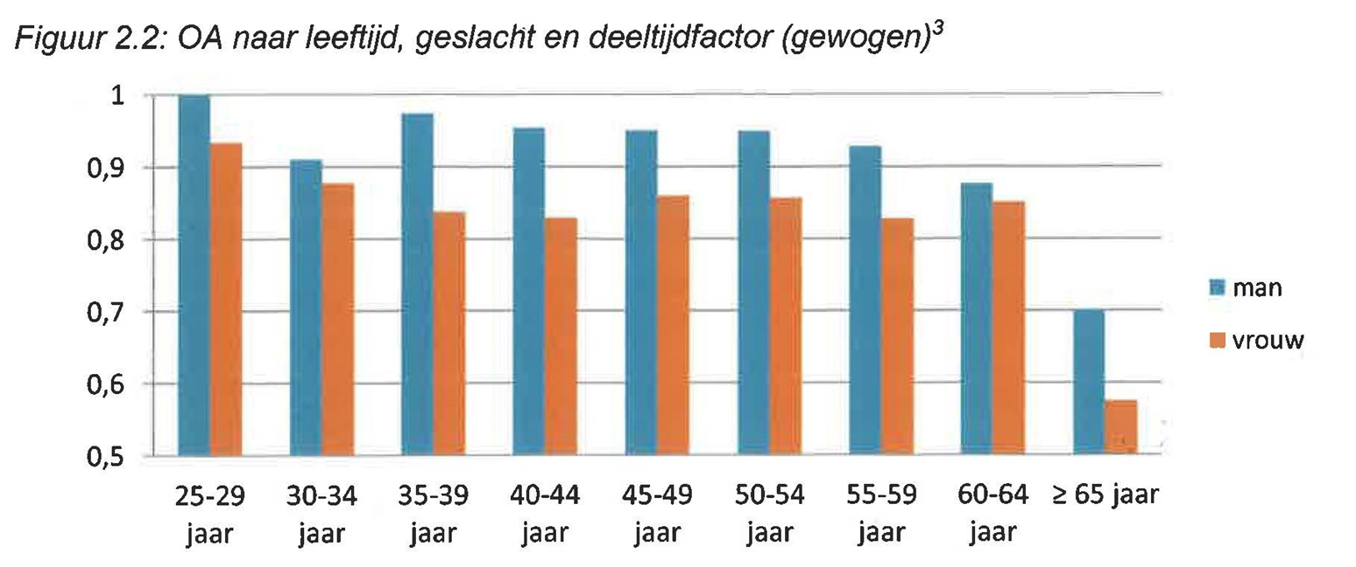
Parttime percentage of Pharmacists
Average: 0,89 FTE
Men: 0,94 FTE
Women: 0,85 FTE
Men
Women
(Bron: Kiwa Carity)

Slide 7
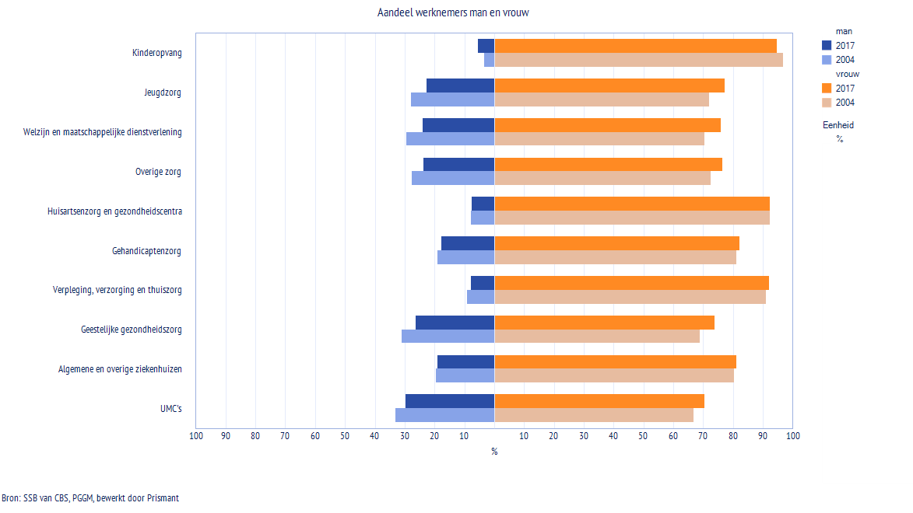
Share men and women per sector (all professions)
Childcare
Youthcare
Social services
Other healthcare
General Practitioners
Disability care
Nursing homes
Mental healthcare
General hospitals
University hospitals
Men
Women

Slide 8
Data Medical Specialists
2009: 33% women
2014: 40% women
2019: 45% women
Big differences between specialisms
Specialism | % women | Specialism | % women
Clinical genetics | 82 | Orthopedics | 12
Clinical geriatrics | 77 | Thoracic surgery | 13
Emergency Room | 69 | Neurosurgery | 14

Slide 9
Implications
General practitioners:
2007: 36% women, average employment = 0,74 FTE
2016: 53% women, average employment = 0,67 FTE
Women are more often employed:
Percentage consults of indepent GP decreased from 89% in 2007 to 80% 2016
Source: Nivel

Slide 10
Implications
Medical Specialists
Under age 40, the number of female MS exceeds the number of male MS. At this moment, more men are leaving the sector than women. Over 20 years, the exodus of MS is as follows:
Male: 61%, Female: 43%
Conclusion: the share of female MS is still increasing
Parttime factor MS 2016: Male: 90%, Female: 85% (so, in the future we need more medical specialists).
Salaried MS: from 37% in 2009 to 42% in 2014

Slide 11
Demands are changing
Research of LAD among psychiatrists shows that:
Sources of energy in work are:
• possibilities for education, research and innovation
• focus on the profession itself
• facilities and support of the organization for providing good care;
• involvement with policy;
• reward and appreciation by management.

Slide 12
Women in leadership
Point of attention:
Only 6-14% of the positions in leadership in the healthcare is occupied by women.
On this topic there still is much to gain…

Slide 13
But: very good news!
Question: is the chance of deceasing smaller when you are treaded by a female doctor?
Fact check (by a Dutch newspaper):
Source: Volkskrant, 10 januari 2017
TRUE!

