Slide 1




Towards a women oriented Medicine
European women doctors’ life and work: facilitations and barriers
FEMS Conference - Naples (I)
May 30th, 2019
Dr Claude WETZEL
SNPHARE European Policy Advisor

Slide 2

French Survey - February 2019
Private/professional life balance for public hospitals’ Consultants
Dr Nicole SMOLSKI (AH/APH) – Dr Lamia KERDJANA (Jeunes Médecins) – Dr Jacques TREVIDIC (CPH/APH)
Actions Praticiens Hôpital, which brings together the 2 inter-unions of hospital consultants Avenir Hospitalier and the Confédération des Praticiens des Hôpitaux, and Young Doctors’ Union, launched a major national survey for all hospital doctors and pharmacists, men and women, of all ages and all statutes. This survey, conducted over a month, was a great success despite its length. More than 3,135 men and women of 44,332 consultants (7%) answered to 120 questions about work-life balance.
Aimed at men and women, it has been of significant interest to women, who make up 61% of respondents (1,912 women). The average age of male/female respondents is 47 years old.
The "young women" answers are those of born after 1974, so under 45 years of age.
The following extraction concerns only the particularities related to the specific aspects of the feminization of the profession, to the problems and difficulties encountered, as part of the day of March 8th (International Day of Women's Rights).

Slide 3
Woman-friendly work and organization in the healthcare system
1,912 women answered (61% of the survey respondents)
  85% Senior consultants, 10% Junior doctors, 5% University Professors
  72% have a full-time position (48h/week, on-call and stand-by duties)
  28% have a part-time position (60% full-time)
Age:
  961 women responding to the survey are born before 1975: 50.2% > 44 years years old
  951 women responding to the survey : 49.7% < 44 years old
In your work have you or did you ever feel being discriminated as a woman doctor?
  57% No, never
  43% Yes, from my colleagues, from my supervisors and from my patients.

Slide 4
Work-life balance
What is your opinion about work-life balance in your work organisation?
  I’m not satisfied at all, neither from a family friendly nor from a career point of view
What would you improve in your work for a more satisfying work-life balance?
    to be able to modulate the career without consequences and so access to more leadership (44% of answers),
    increase in remuneration is noted in 2nd position (43%),
    less working time per week/part-time work (40%),
    hospital nurseries open to doctors’ children (34%),
    positions’ replacements for easier maternity leave (32%),
    be able to better predict the time of exit from work in the evening (31%).

Slide 5
Professional career
Are you satisfied of your professional career?
  No, but I preferred to dedicate more time to my family
Do you think in your workplace there is a fair involvement of women doctors for management roles?
  No at the moment, but there is a growing attention on this topic
In your country is there any law or collective agreement that is in your opinion, women or family oriented?
  Not in the Health Sector

Slide 6
General data
Number and % of women students in Medical Schools
57,791 students (67% women) in PACES - 1st year common for the health professions (ranking examination with 20% success for medicine)
8,205 medical students in 2nd year of medical training
after PACES (62% women)
45,539 students (61% women) in the 43 French Medical Schools during the 5 years of general medicine training (master)
33,747 students in postgraduate training (57,5% women)
792 women members (42.5%) in the SNPHARE medical trade union and 8/21 women in the SNPHARE Board (38%)

Slide 7
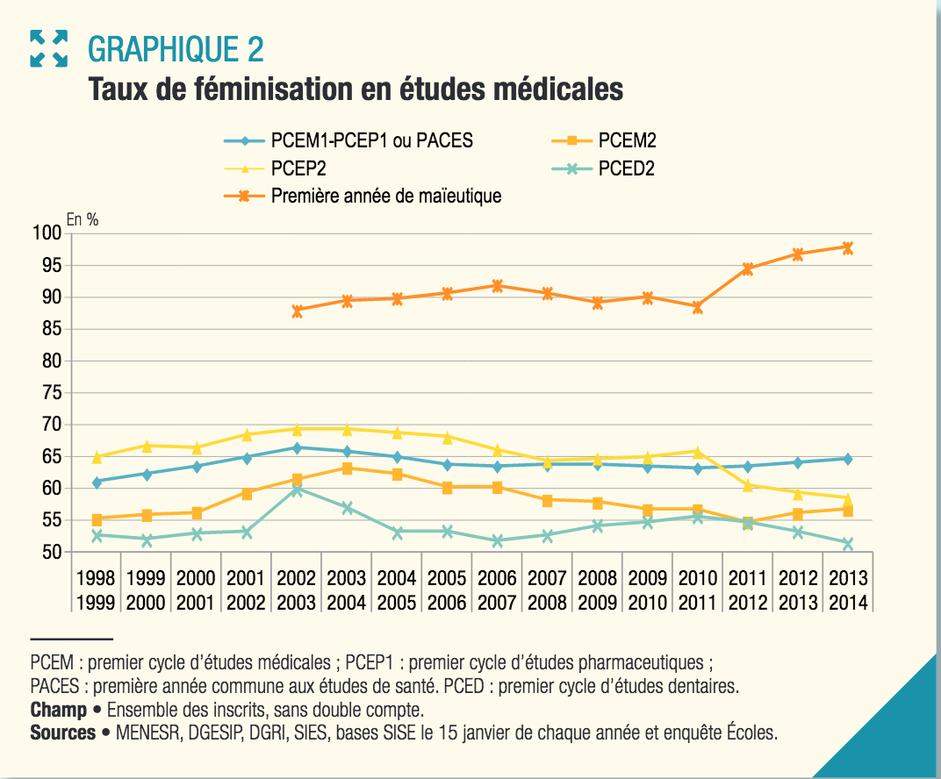

Slide 8
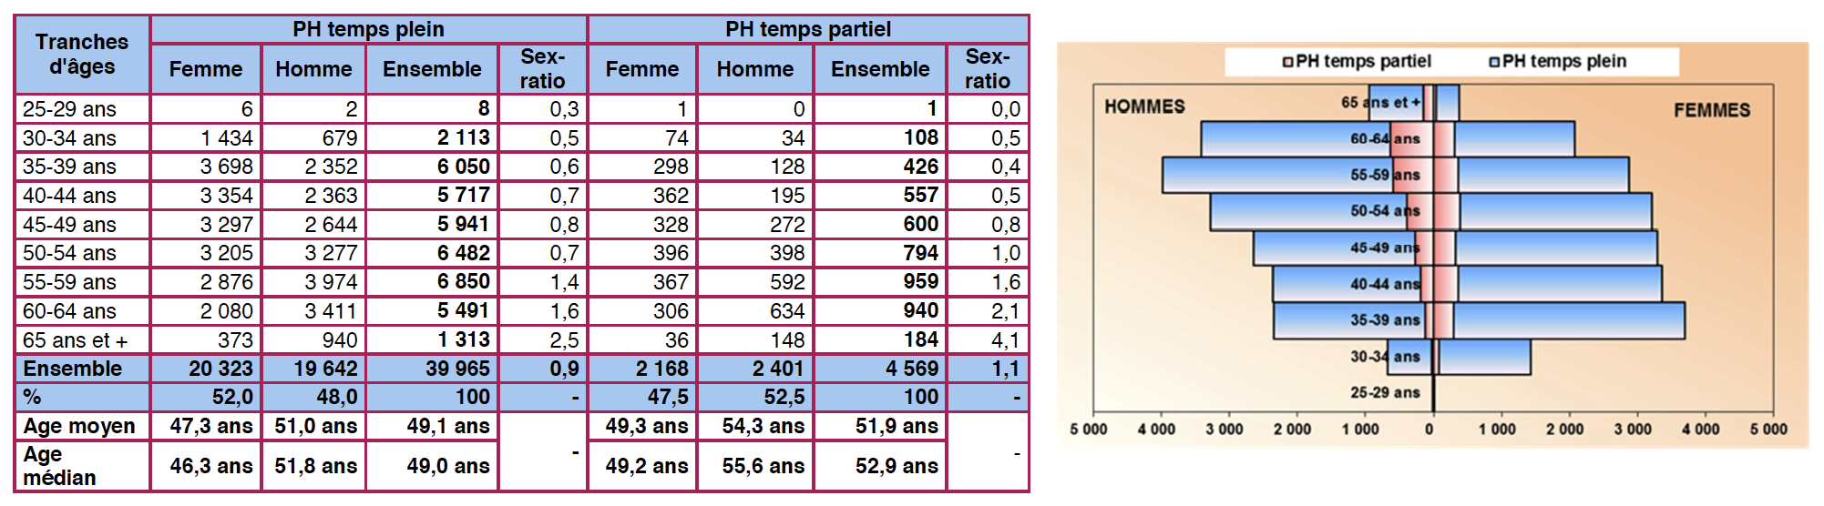
Consultants in the Public Hospitals
605 French public hospitals: 32 University hospitals – 573 nonU hospitals
44,534 Consultants: 39,965 (90%) full time (48h/week) – 52% are women
4,569 (10%) part-time (30h/week) – 47.5% are women
source : CNG-SIGMED 01/01/2018

Slide 9
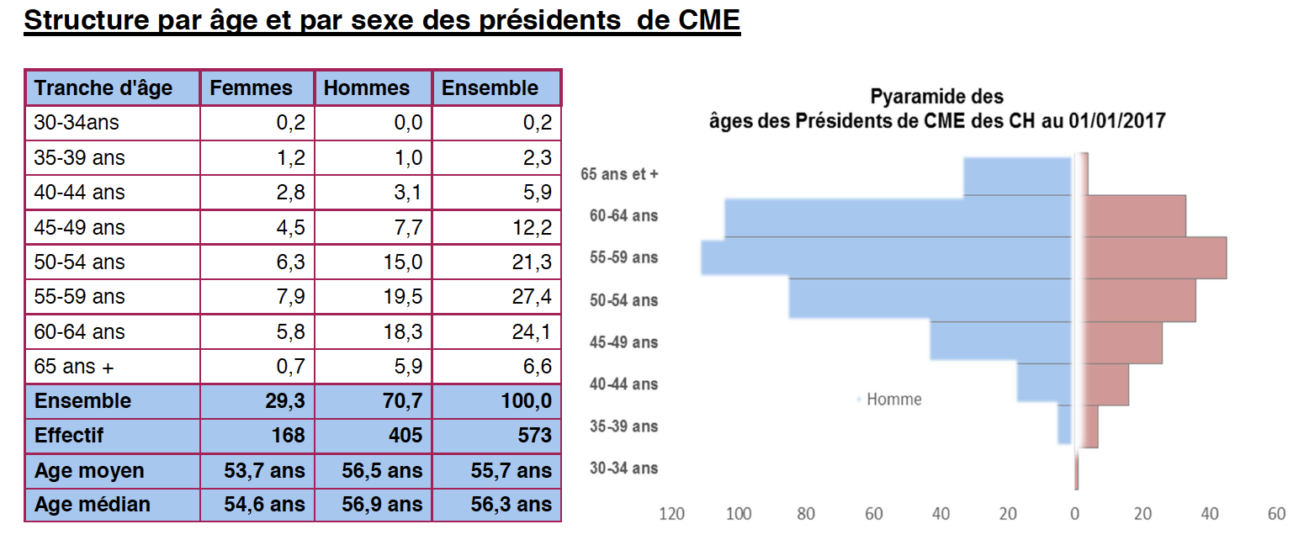
Women in leadership positions
Medical Councils’ Presidents in the 605 French public hospitals:
32 University/Regional Hospitals: 30 men Professors - 50% > 60 years old
573 non University Hospitals: 168 women (29.3%) - 405 men (70.7%)
Head of Departments: same ratios (30% women)
source : CNG-SIGMED 01/01/2018

Slide 10

Trade Union proposals
Improve the basic salary to be able to stop the on-call duties (nightshifts) at the 3rd month of pregnancy (58% women cannot)
Free access of hospital nurseries to doctors’ children
Creation of hospitals’ premises for breastfeeding
Creation of short replacement contracts allowing the taking of maternity leave (6% women cannot)
Better organization of teams to allow doctors to take part in CPD actions (55% of women give up to protect family life time)
Moving towards the parity of responsibility positions (University Professors, Presidents of Medical Councils, Head of Departments)
Creation in each hospital of an Observatory of sexual discrimination and harassment (15% women are victims), with sanctions

Slide 11


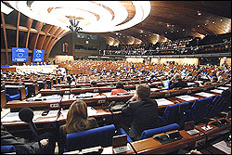
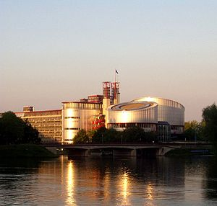
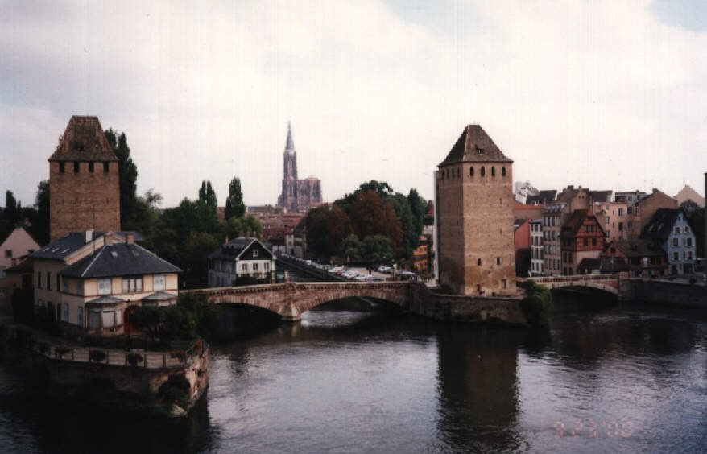

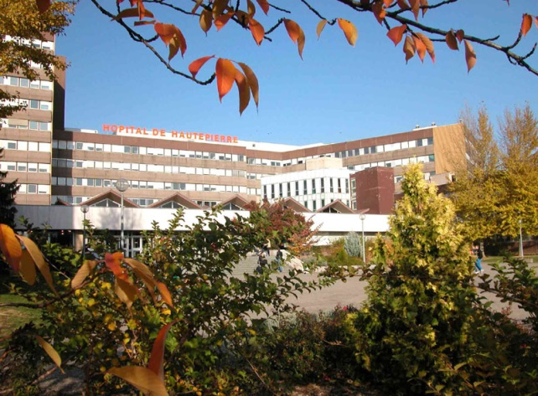

Strasbourg
European Institutions
Many thanks!
University Hospitals

