Slide 1

FEMINIZATION
Number of students in medical faculties 2018: 7.080 → 67% women
Only 20% of management positions are held by women.
- In the management positions of CESM, 25% are women. But they are majority in the managerial positions of:
* Aragón
* Navarra
* Madrid
- In parallel with the increase in the presence of women in medical training, it increases its presence in managerial jobs, as well as in managerial positions of the Medical Union.
< 35 years old | De 35 a 44 | De 45 a 54
11,3 % | 13,3% | 16,9%
24,9% | 23,7% | 21,5%
De 55 a 64 | De 65 a 69 | > 69 years old
32,7% | 10,5% | 15,5%
23,3% | 3,9% | 2,7%
Men
Women

Slide 5


Slide 6
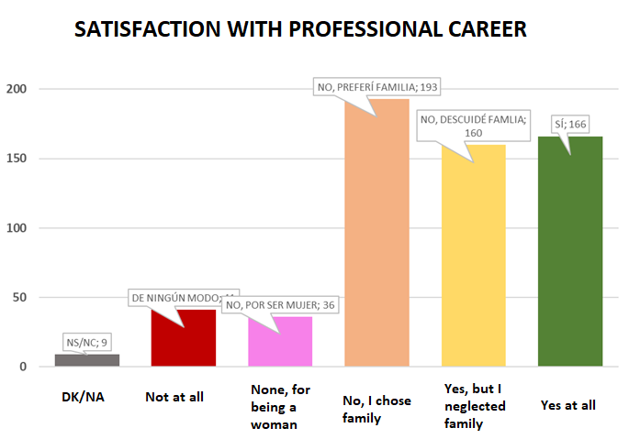

Slide 8
